Slide 1





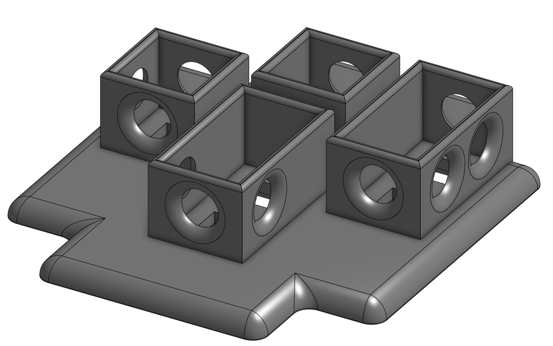
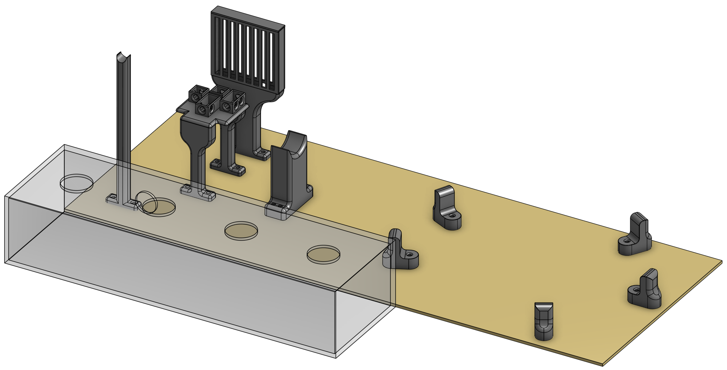
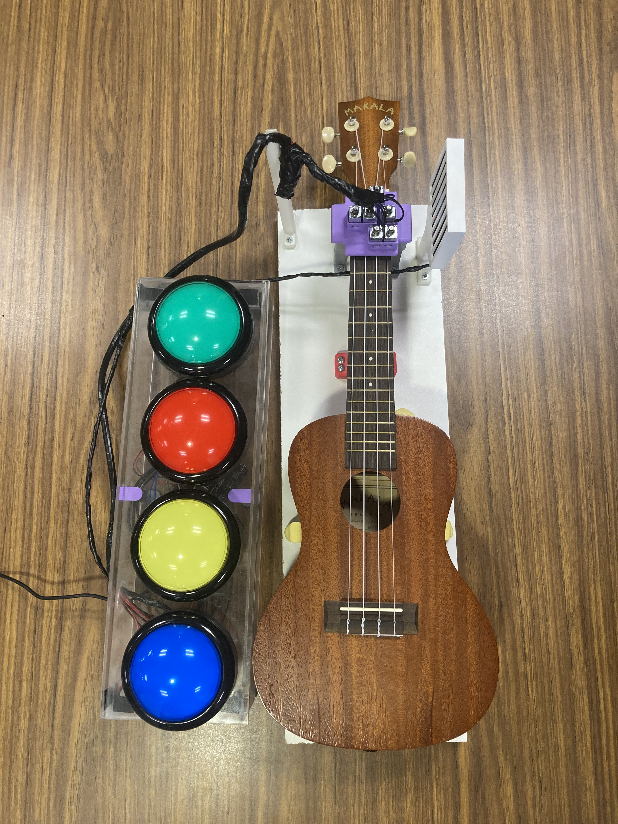
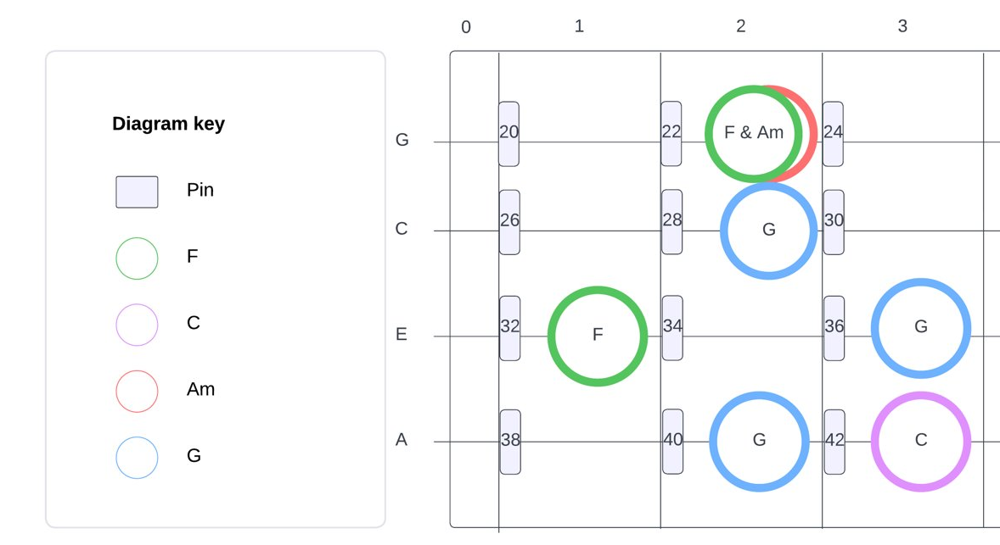
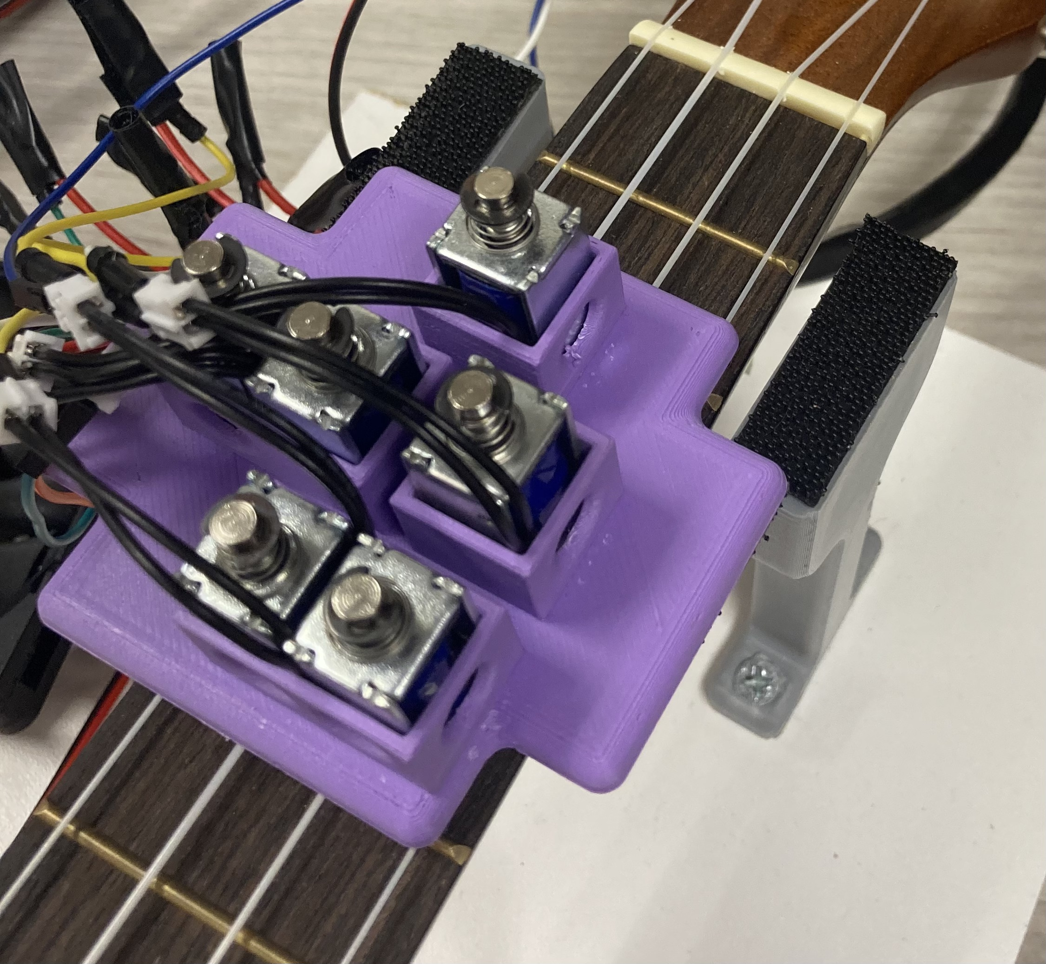
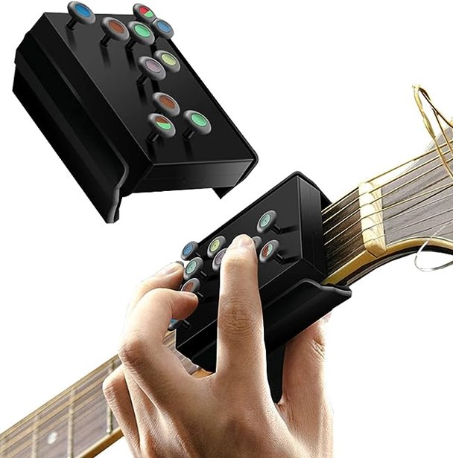
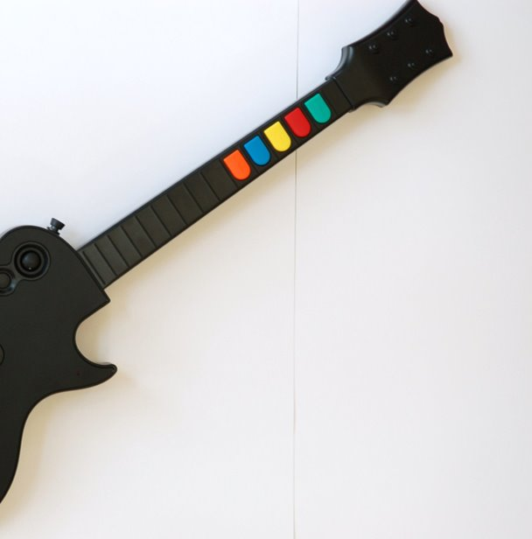
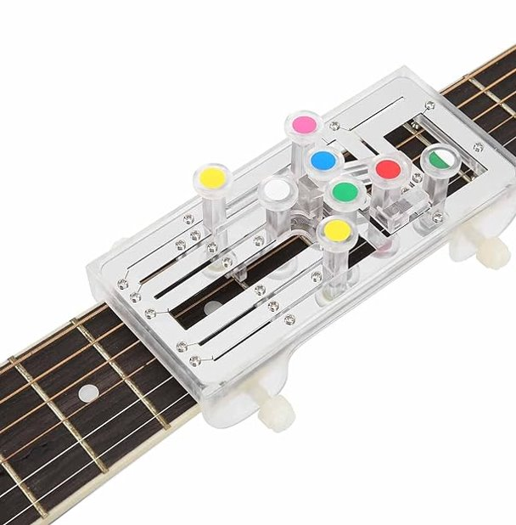
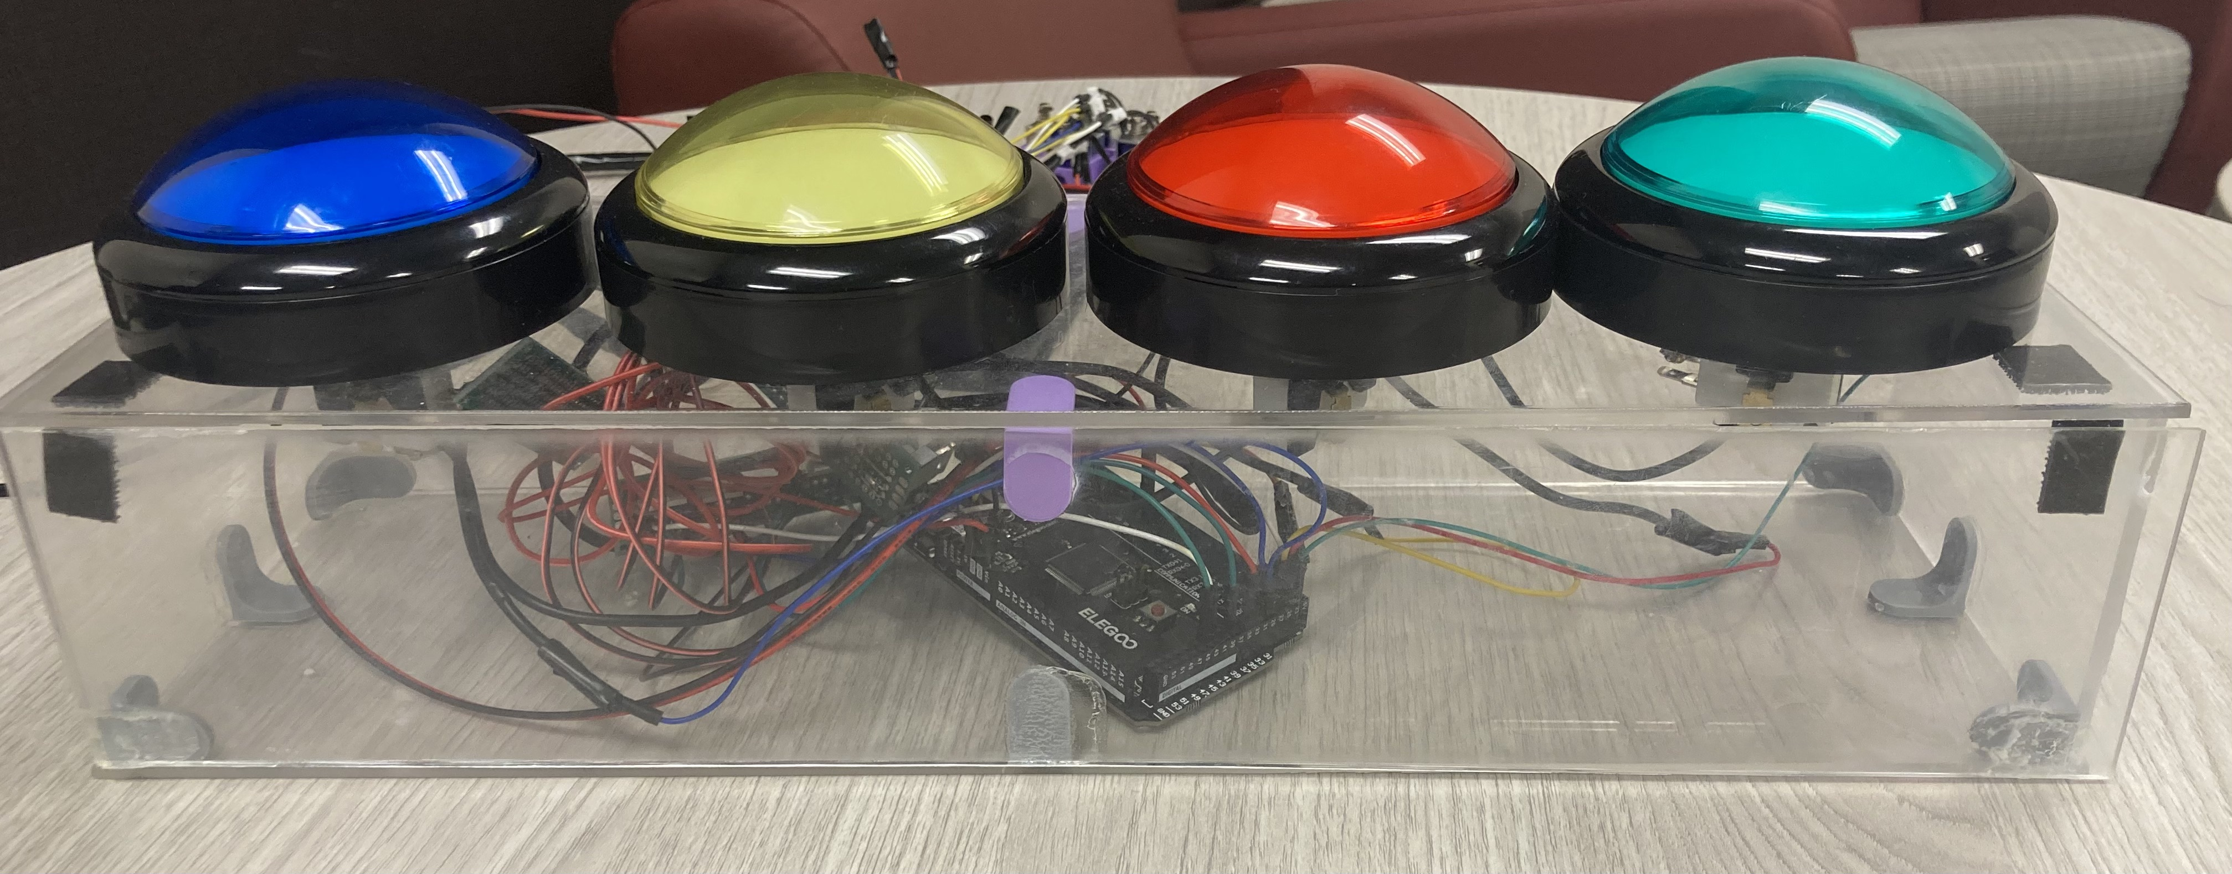
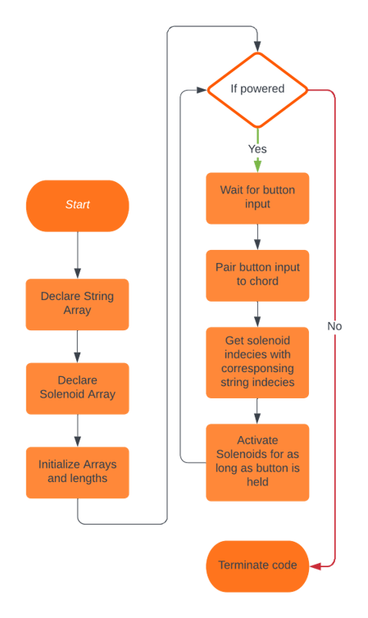
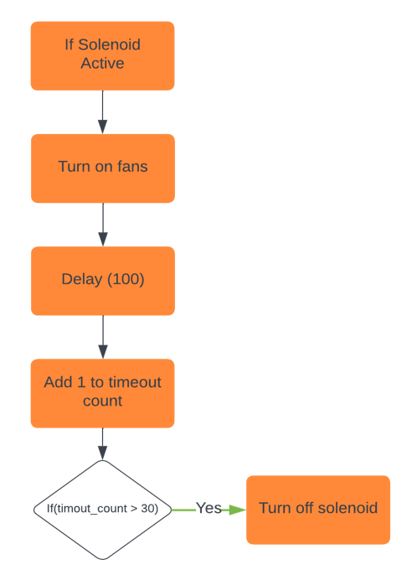
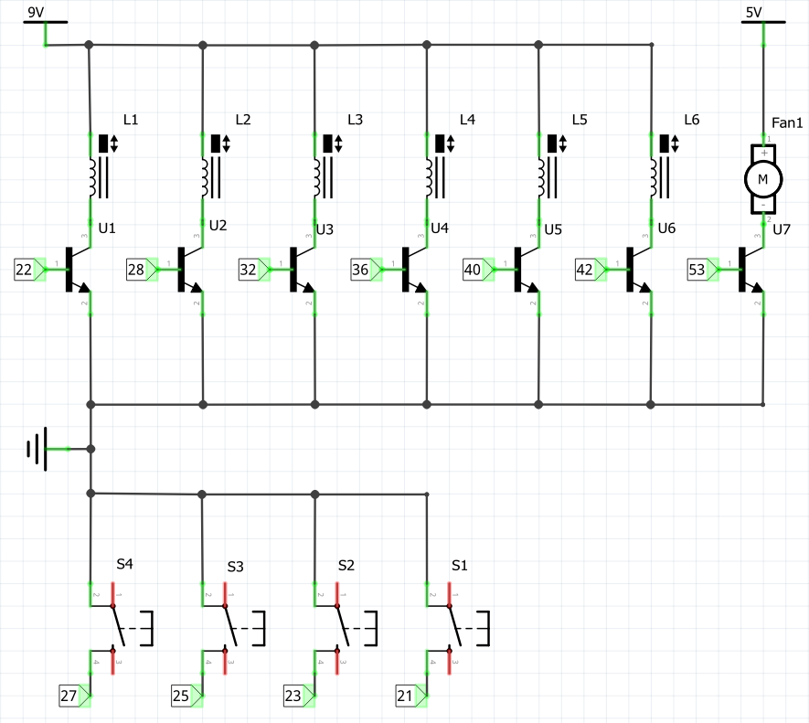
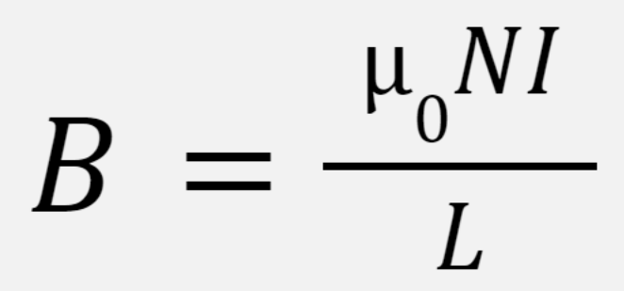
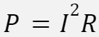
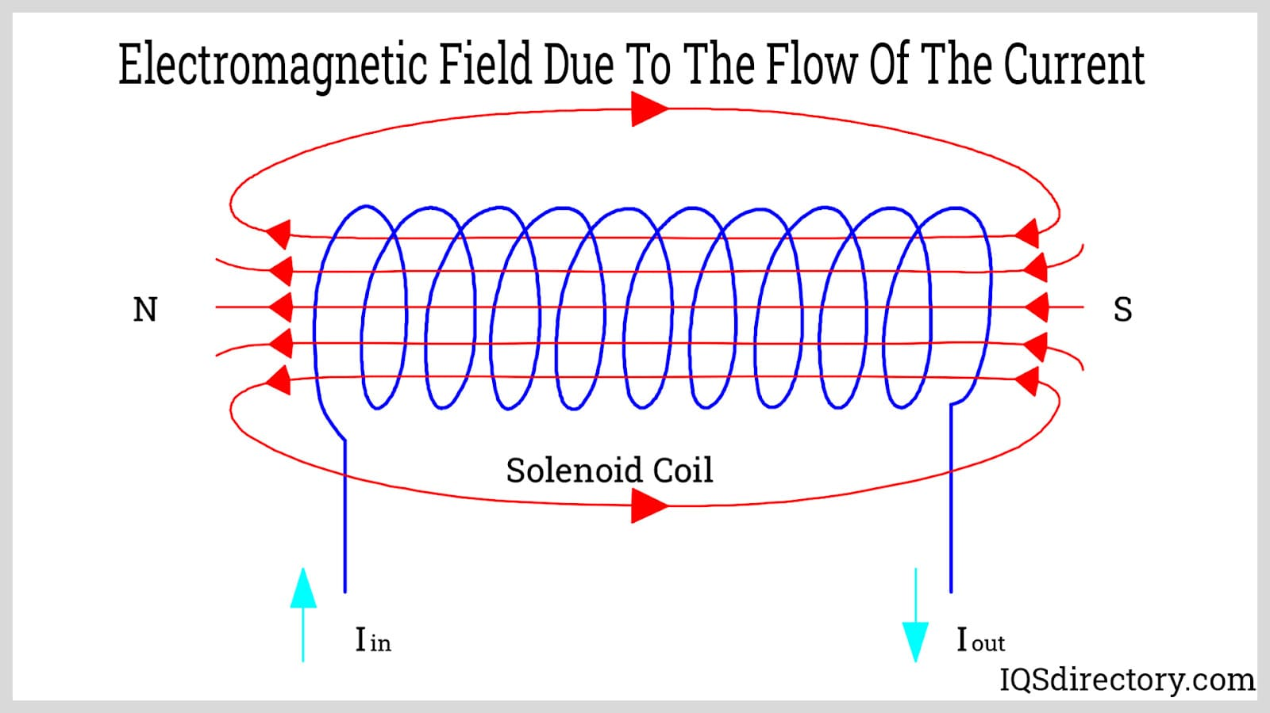
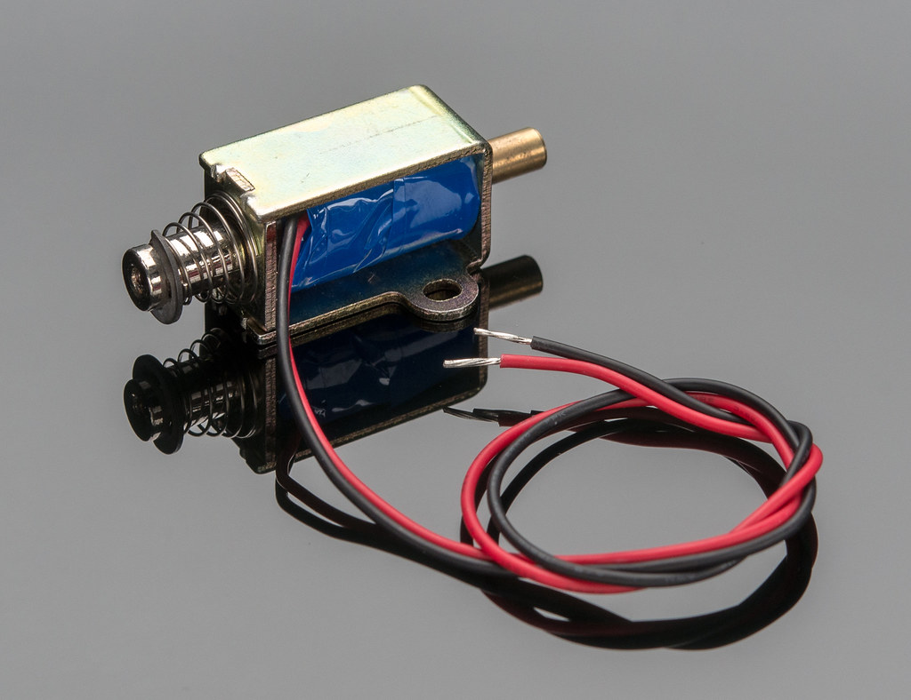
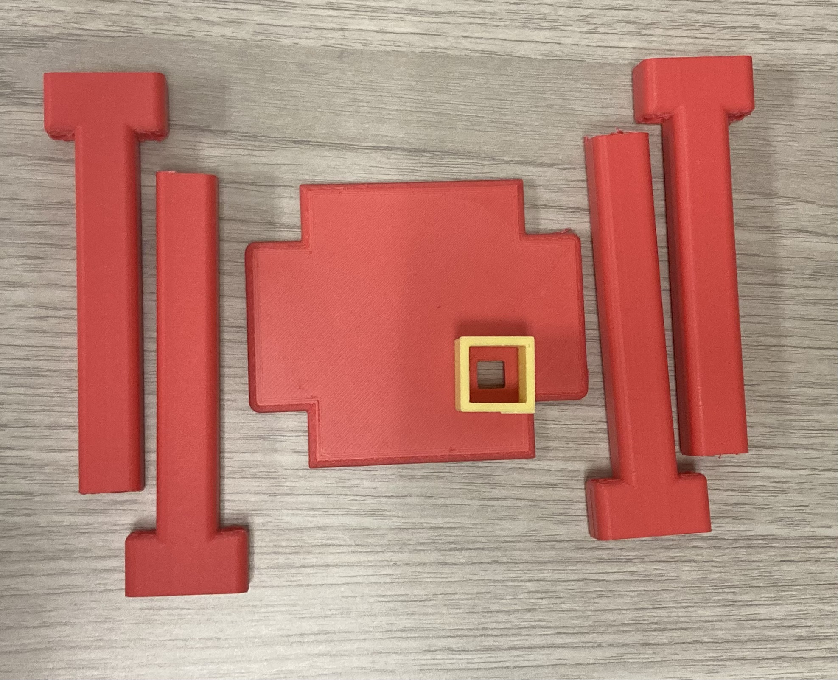
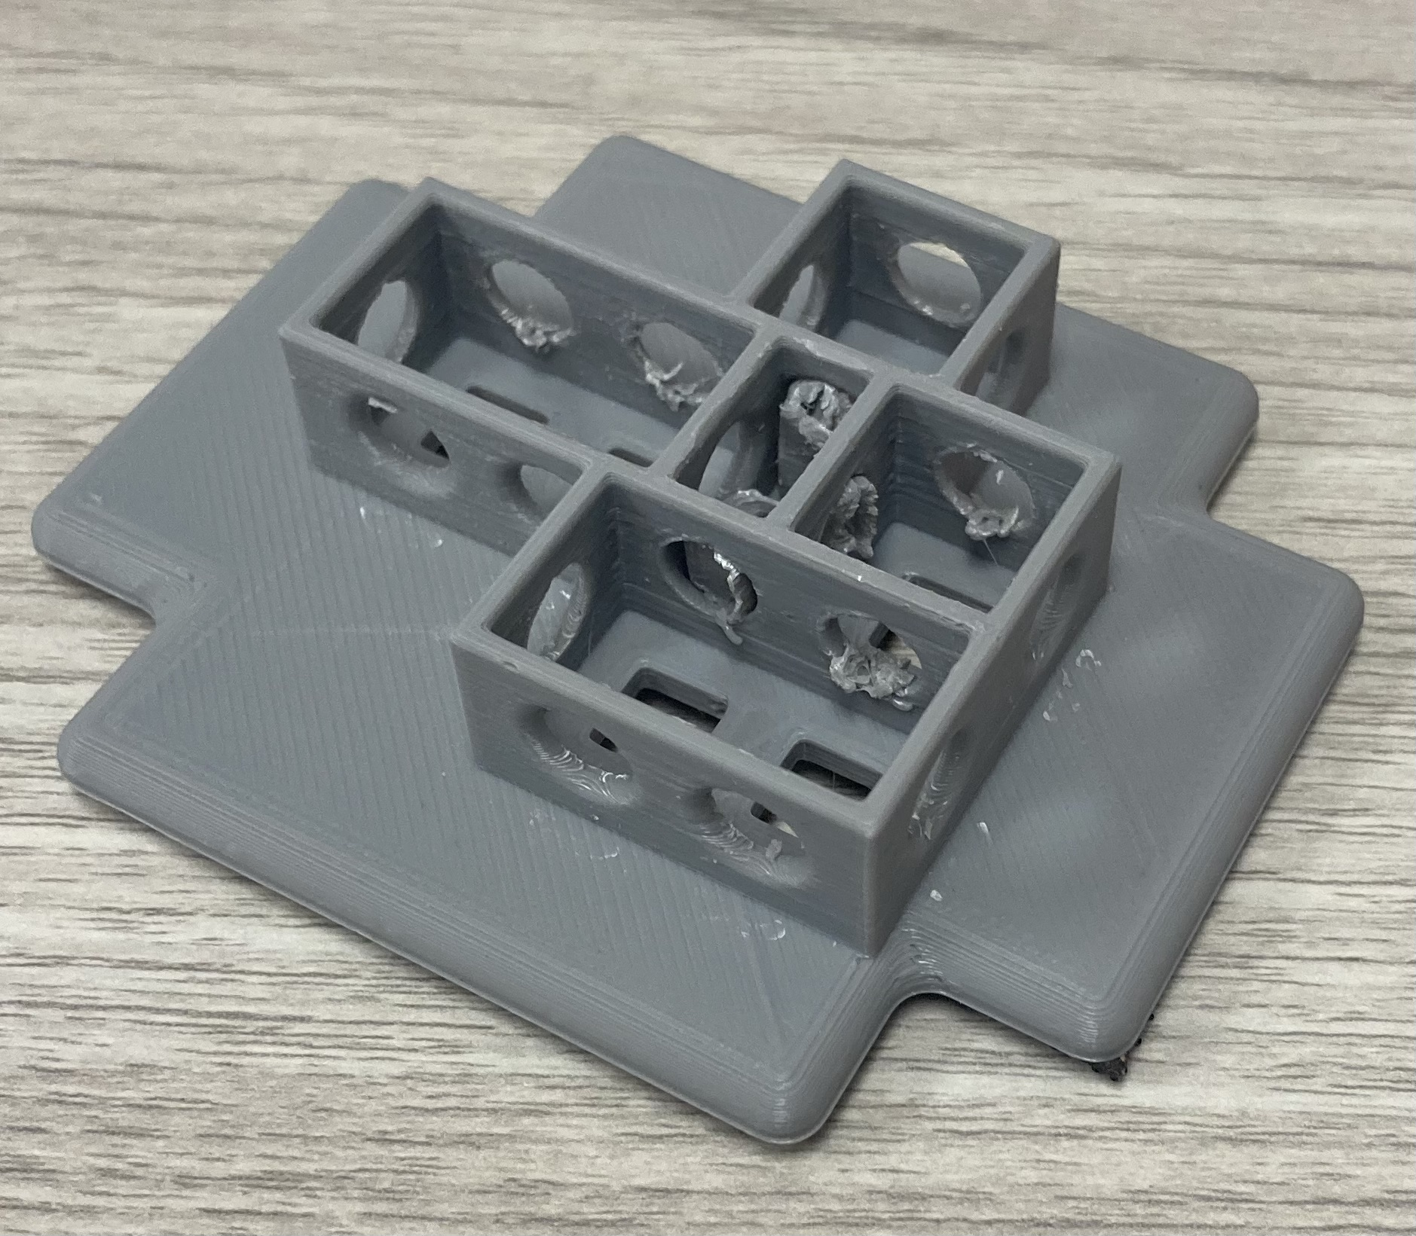
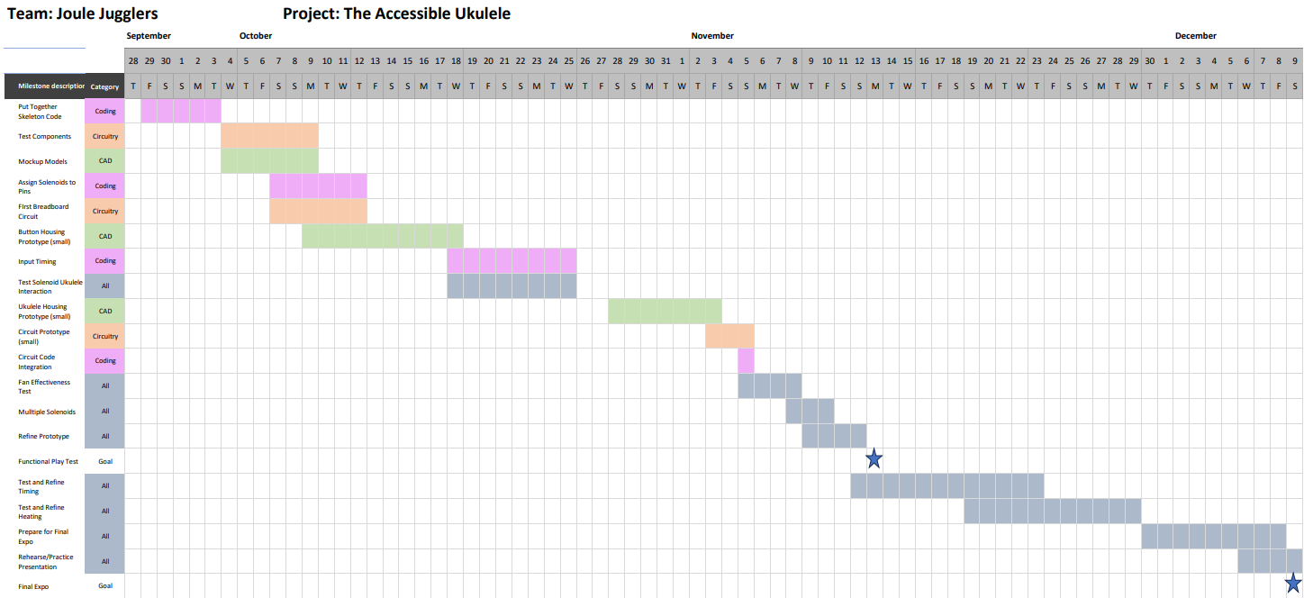
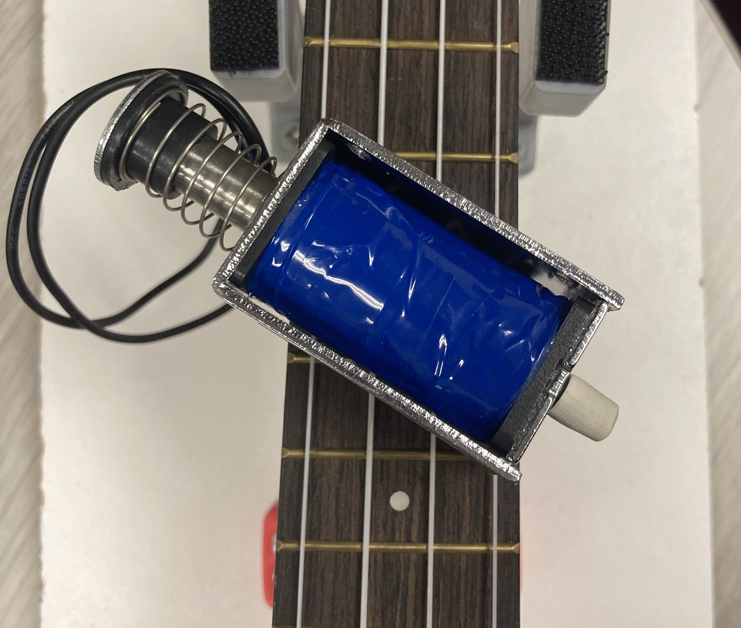
Joule Jugglers: Kaleb Keller, Ryan Loar, Kameron Lund, and Dominic Pedavoli
Piket-May - ECEN1400 Section 100 First Year Engineering Projects – Fall 2023
Accessible Ukulele
Project Background
Engineering Design & Process
Housing
Mission Statement: Our mission is to provide an equal musical playing experience for everyone, irrespective of physical ability, and to harmonize the world of music through the expression of the ukulele, for the love of music.
Our Clients: Amputees and individuals with motor control disabilities.
Solution: An accessible design that allows for the simple push of a button to be converted into linear motion that presses down different chords.
Solenoid Housing
Solenoids are held in a 3D printed unit that precisely places the 6 solenoids over their respective strings and frets
Housing is detachable via Velcro
Holes in sides of solenoid ports to allow cooling
How it works
Dimensions
Overall Footprint: 10" X 26"
Height: 7"
Solenoid Housing Model
Solenoid Housing Unit
Fan
Complete Housing CAD Model
Lessons Learned
Solenoid Housing
Solenoid to Chord Reference Sheet
Technical Development: All Members learned CAD, Laser Machining, Soldering, and 3D design to help put the project together and ensure its success.
Team Development: Each member came forward and displayed one or more of their strengths/talents to help complete what needed to get done on time while making sure their work is up to standard.
Design Inspiration
Electronics & Button Housing
Box is made of 1/8" laser cut acrylic
Box houses the Arduino mega, circuitry, and buttons
Port in back for
wire access
Electronics & Button Housing
Ukulele Resting in Stand
Each button is linked to a set of solenoids which correspond to a specific chord.
Press a button and strum the ukulele to achieve the same effect of playing a chord in a typical way.
All the logic and timing is handled by an Arduino mega in the clear box, which also provides the power through a 9V wall plug.
Beginner Guitar Gadgets
Our team noticed that these devices allow the user to play a full chord at the press of a button. We were inspired to create a similar device for the ukulele using solenoids.
Button and Electronics Housing
Future Developments
Beginner Chord
Guitar Hero
EZ Fret
Software flow charts
Final Accessible Ukulele Design
Electrical Design
Implement additional solenoids allowing the user to play more chords
Finding alternative solenoids that are similar in size, yet output the minimum force required without being overdriven
Buttons:
Each button corresponds to a chord.
Fan
What is a Solenoid?
Fan:
Solenoids
A solenoid is an electromagnetic device that generates a magnetic field which pushes a plunger forward.
Fan is connected and controlled by the Arduino.
Budget
B = magnetic field strength;
μ0 = permittivity of free space; N = number of turns; I = current;
L = length of solenoid;
P = power;
V = voltage;
Transistors:
Quantity & Product | Price Per Item | Total Cost
6 5V Solenoids | $5.50 each | $33.00
6 13.2 x 12.1 mm Copper Heatsinks | $1.95 each | $11.70
6 Transistors | $0.00 each | $0.00
4 Buttons | $12.95 each | $51.80
1 Arduino Mega (ELEGOO) | $21.00 each | $21.00
1 30 x 30 mm fan | $3.50 each | $3.50
1 9V DC Power Supply | $14.00 each | $14.00
Total | - | $135.00
Margin | - | $165.00
Magnetic Field and Current
Each transistor corresponds to a solenoid, allowing the Arduino to activate desired solenoids.
Switches (Buttons)
Solenoid Render
Prototyping
Main Code – Block Diagram
Safety Mechanism – Block Diagram
Electrical Schematic
Initial Housing
Initial solenoid housing prototypes proved to be weak and did not fit correctly on the neck of the ukulele
Solenoid Testing
The 5V solenoids did not have the force output required to press the string while running 5V through them
Explored bigger solenoid that worked however it was too big
Finally tested overdriving 9V
through the 5V solenoid and
it worked
Testing
Safety Concerns
Gantt Chart
Solenoid Housing Prototype 1 (Left)
Solenoid Housing Prototype 2 (Right)
Our main concern was with the heat of the solenoids​
Below is the data we gathered on the effect of fan cooling
Potential exposure to live wires (as few as possible with our constraints).
Solenoids are prone to producing a large amount of heat.
Fan engages when the solenoid(s) are active, ensuring that the solenoid never reaches above 100° F.
Fans use convection cooling to push air past the solenoid housing, dispersing the heat.
Our main concern was with the heat of the solenoids.
Below is the data we gathered (three trials) on the effect of fan cooling on the surface temperature of solenoids.
Seconds Activated | Temperature °F (No Fan) | Temperature °F (With Fan)
0 | 72.34 | 74.71
22.5 | 75.55 | 79.99
45 | 87.02 | 85.26
67.5 | 95.22 | 89.66
90 | 103.70 | 93.17
Heat Dissipation
Large Solenoid
Acknowledgements
Surface Temperature Data
Professor Melinda Piket-May, Tim May, Jonah Spicher, and
Rylee Beach.

